Slide 1
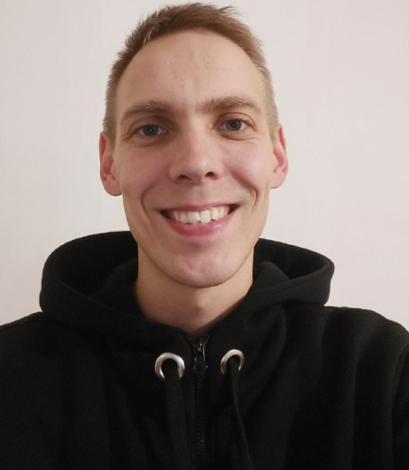
Shortly about myself
An open person with a desire for self-development and learning, I have over 10 years of experience in networking and information technology.
I think, that the key to success in any business is hard work, a good sense of humor and striving for the best.

Slide 2
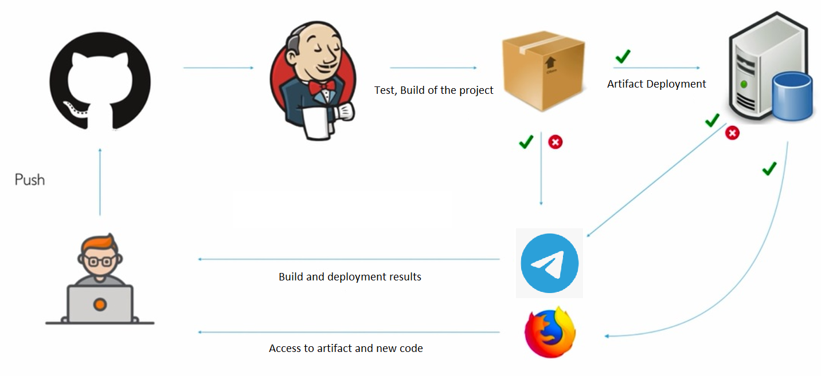
My goal

Slide 3
Main questions :
I have a resource limit (time, money, equipment, experience…), what tools can I use?
How can Jenkins know about a new commit in the repository (push and pull paths)?
I need a reproducible and fast infrastructure creation with backup.
I need to have pipeline status notifications.
The whole process must be secure.

Slide 4
Tools used:
OC Microsoft Windows 10 (host computer).
Vagrant by HashiCorp.
Virtual Box Oracle VM:
- Ubuntu 20.04 LTS (bridged):
- Jenkins.
- Docker:
- Apache Maven.
- Telegram Bot.
Git hub
Docker Hub

Slide 5
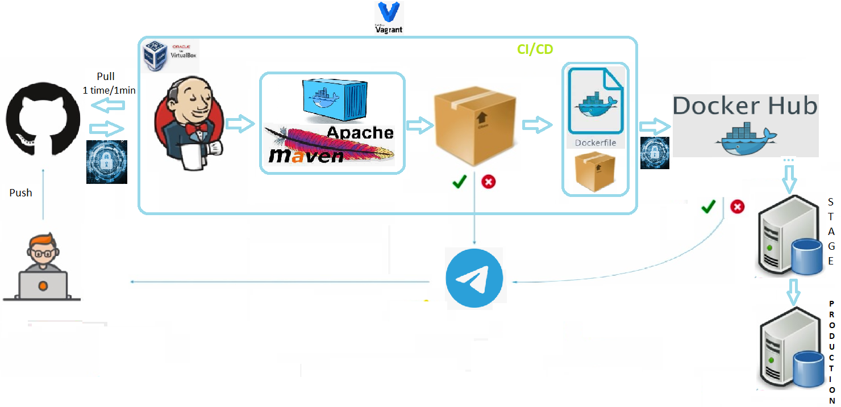
My pipeline

Slide 6
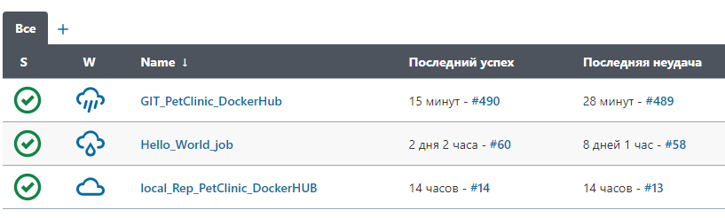
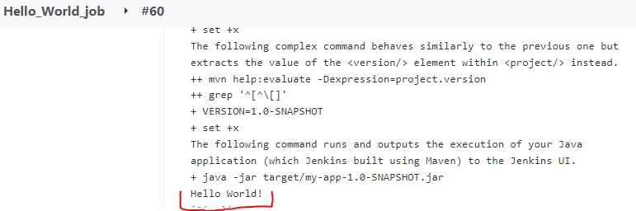

Slide 7
